Slide 1


ONLINE SHOPPING WEBSITE LIKE FLIPKART
GHARDA FOUNDATION’S
GHARDA INSTITUTE OF TECHNOLOGY A/P:-LAVEL, TALUKA: KHED,DIST. RATNAGIRI, STATE:MAHARASTRA, PIN:- 415 708
TELEPHONE NO:- 02356-262795/97/98 FAX NO :- 02356-262795
Group Member : 06 Sagar Hiraman chaughule.
53 Shubham Shivaji Raval.
62 Digambar sawardekar.
26 Manish Kadam.
Under the guidance of
Prof-Mr. Anirudh Mangore sir
Academic year-2021-2022

Slide 2
Index
Sr.No | Content
1 | Introduction
2 | Aim of Project
3 | Output images
4 | Conclusion and Future Scope
5 | References

Slide 3
Introduction
The project entitled as “ONLINE SHOPPING WEBSITE LIKE FLIPKART” is developed by T.E Computer Department students of
Gharda Institute of Technology [GIT].
The project is based on “HTML and CSS” .
The softwares used to construct this project are listed below:
Notepad ++
The output of these program is shown in the google chrome, when we run the program in google chrome , The front page of the website will open the front web page divided into 5 different parts which are as follows:
Header part
List of drop down contents
Advertisement sliders
Products
Footer

Slide 4
The first header part contains the logo of the website ,search box and search button , login and signup , more option ,and the option of cart with the image of cart.
Second part contains the drop down list of the different type of products like electronics , home and furniture , TVs and Appliances and many more options .when user moves the mouse cursor on that option the dropdown list of available items is shown to the user.
Third part of this webpage showing the advertisement images to the user ,which are moving automatically after 1 second like the slide show .
Fourth part of the page shows the different products with there images that products are , earrings , school bags, earphones, kitchen appliances , mobile , pen drives , teddies. That products are shown with the name of product, star rating,
Price and one button of show details. After clicking on that show details button user will reach at the another webpage which contains all details of the product
Fifth part of this webpage is the footer part which shows the 4 different options.
Quick links
Follow us
Contact us
Search
Follow and contact contains the details of the developer.

Slide 5
Aim of the Project
With the help of the project “ONLINE SHOPPING WEBSITE LIKE FLIPKART" the user can easily get the Information of the product.
The project is made using the HTML and CSS language in the notepad++ , hence the project used by anyone, the user dose not need any programming Knowledge.

Slide 6
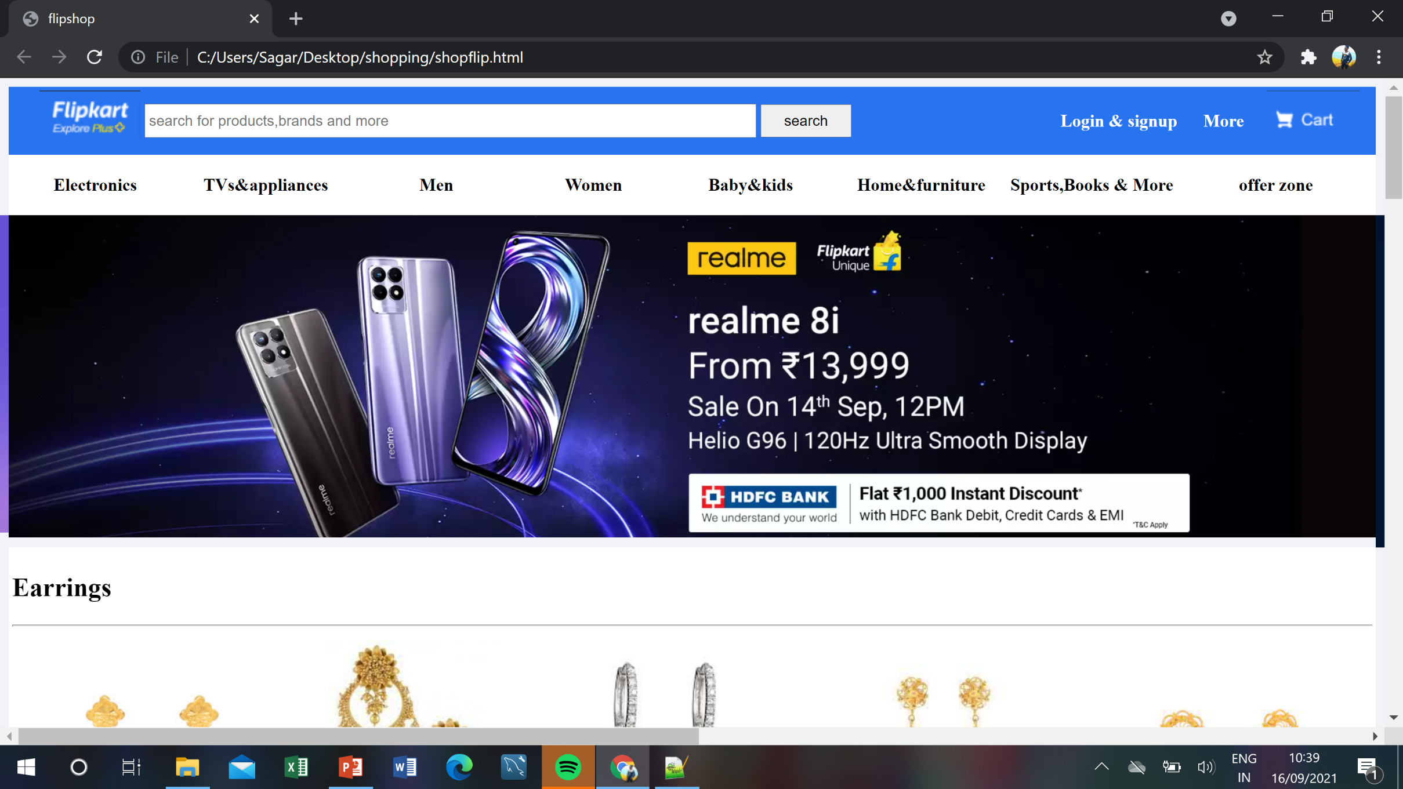
Output

Slide 7
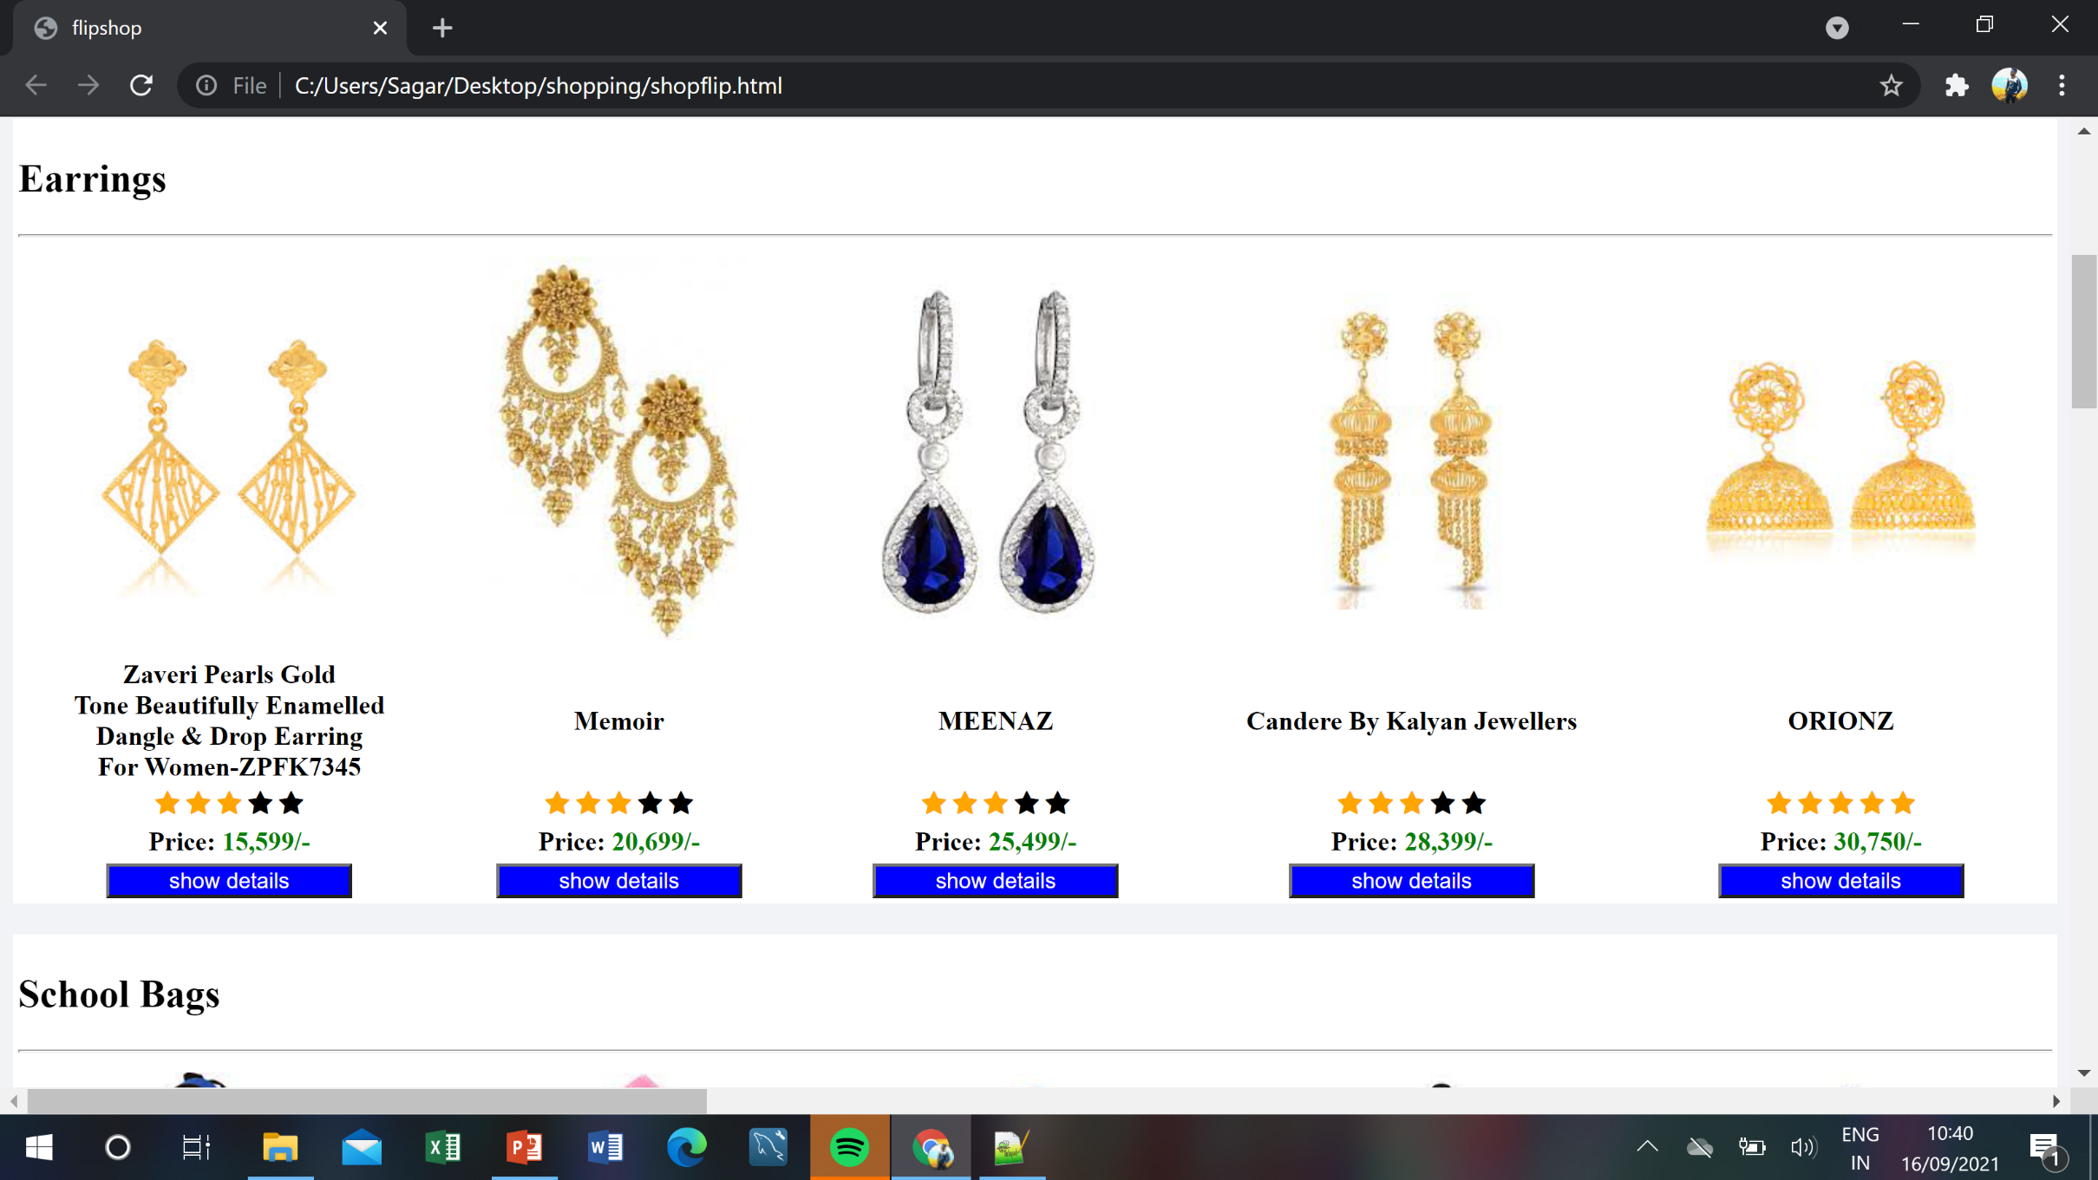

Slide 8
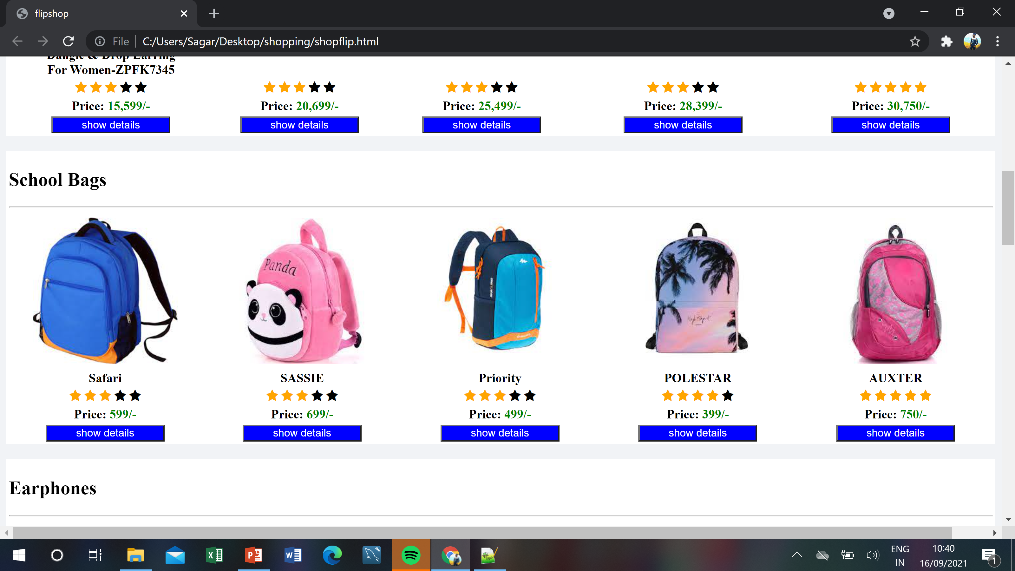

Slide 9
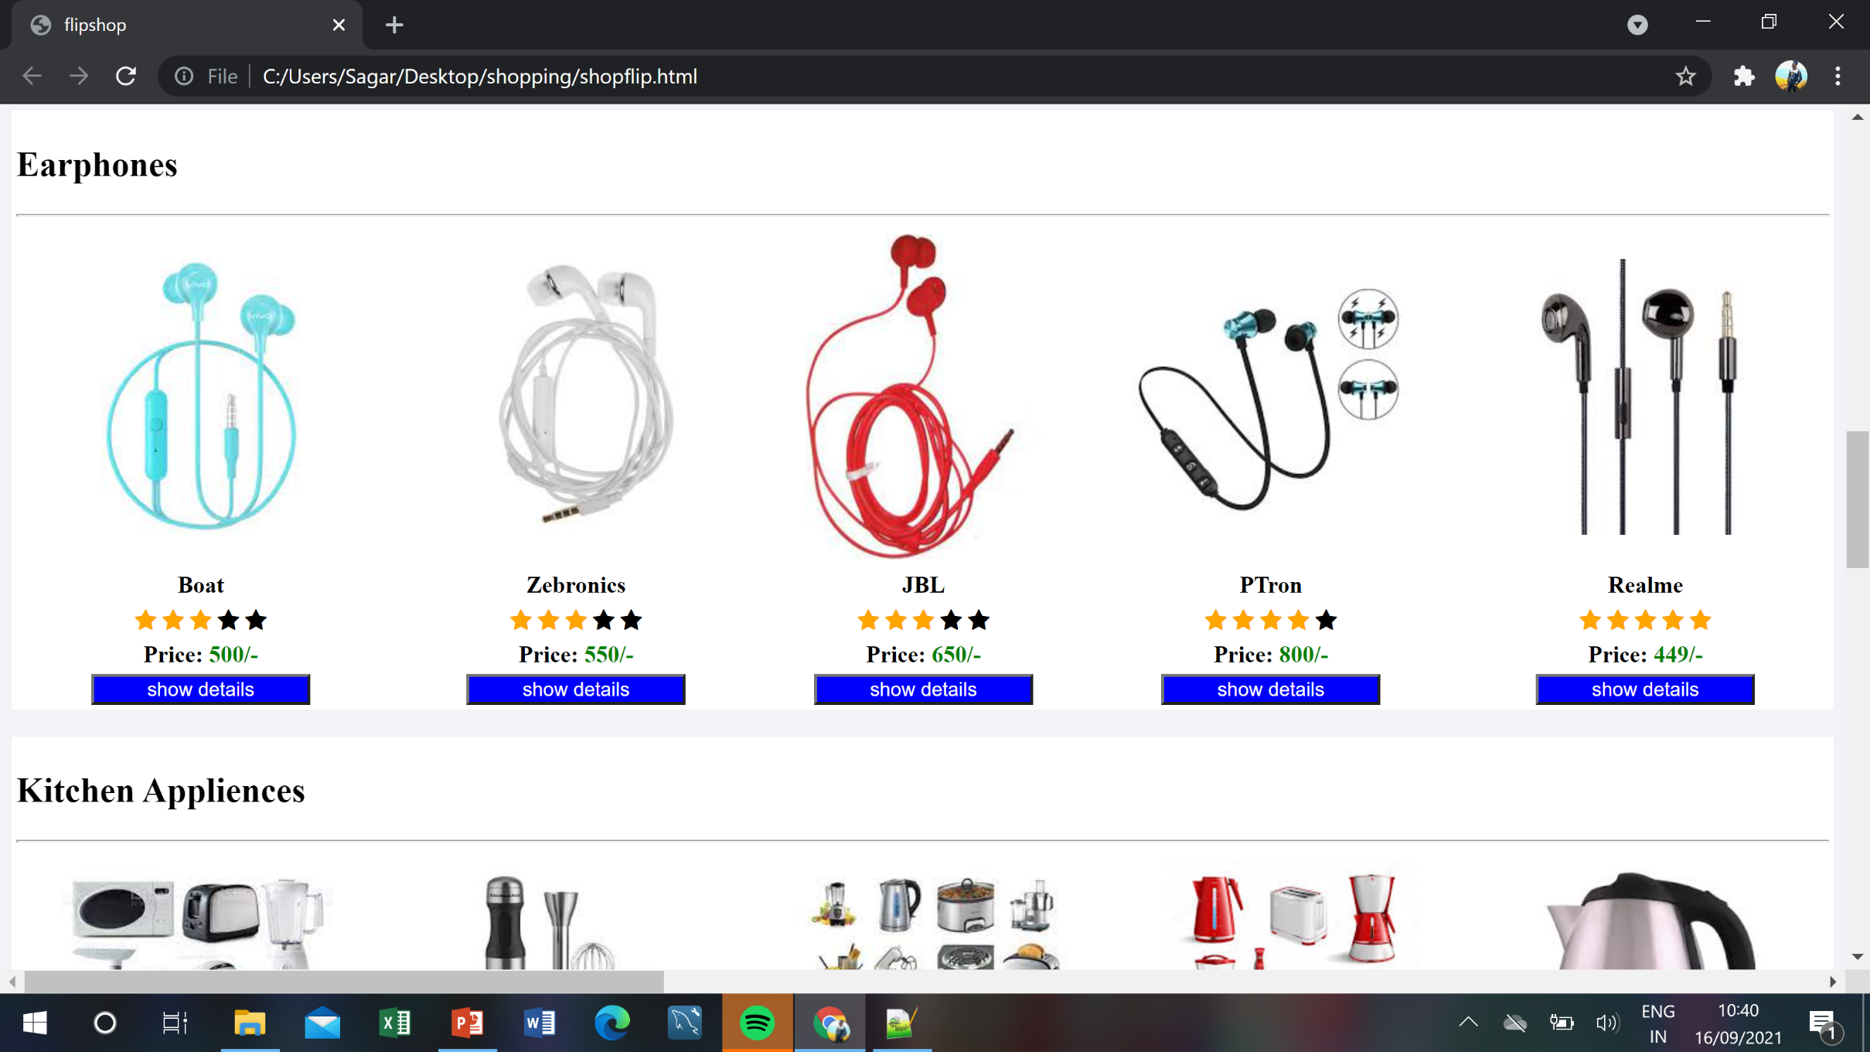

Slide 10
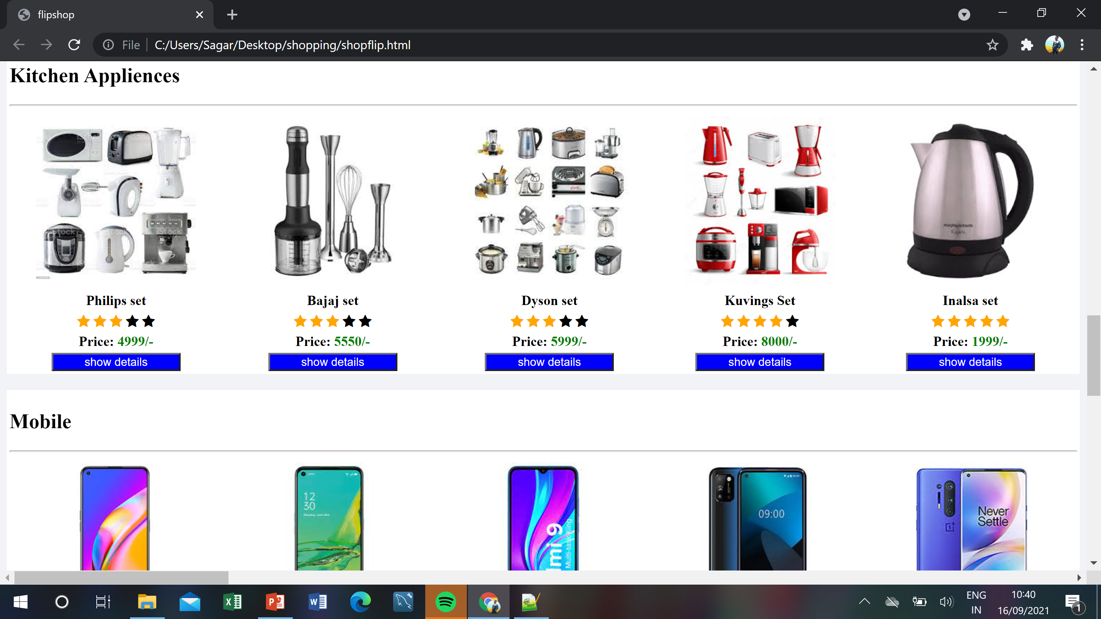

Slide 11
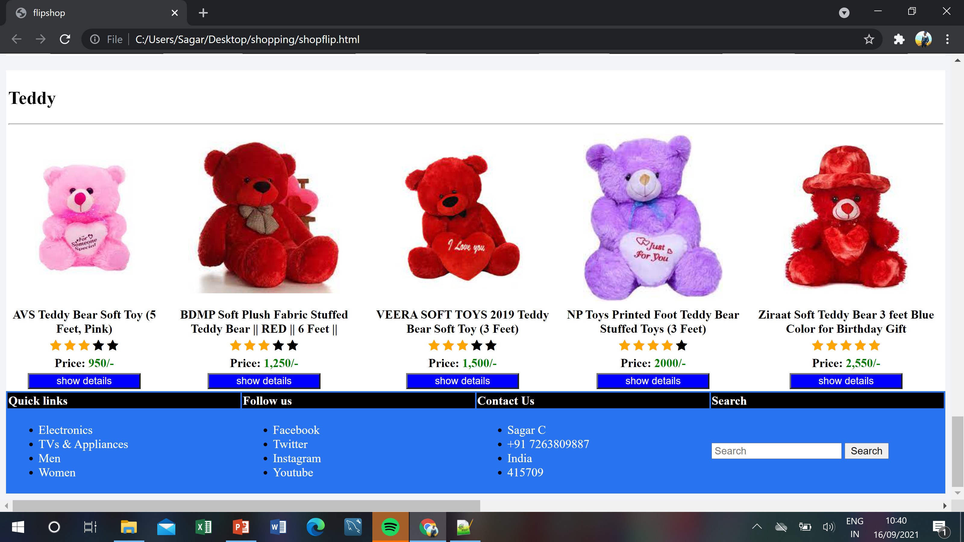

Slide 12
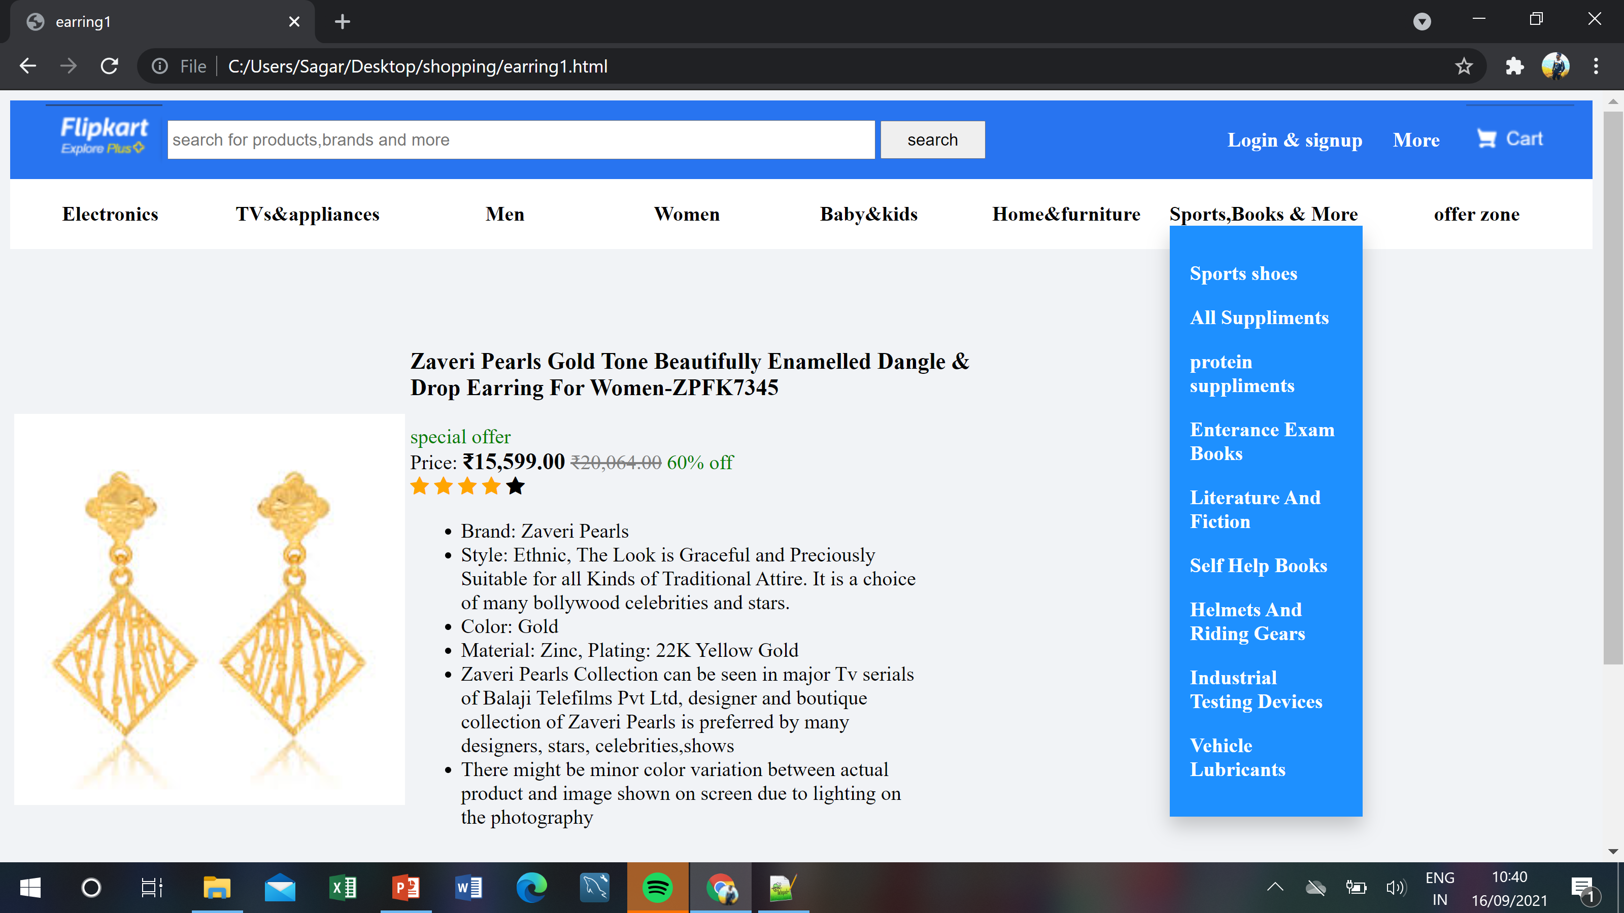

Slide 13
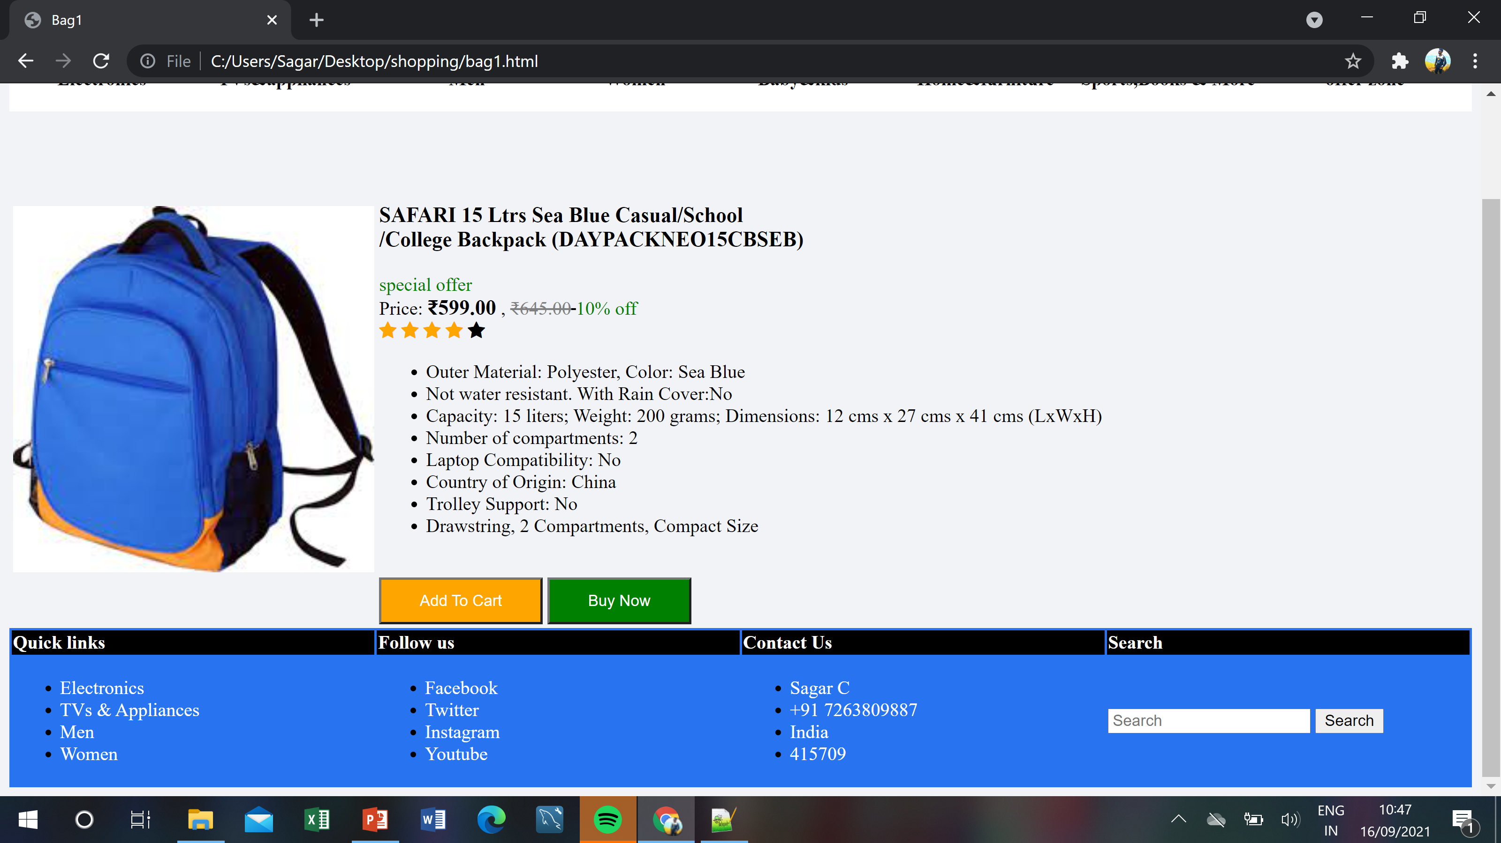

Slide 14
Conclusion and Future Scope
We can conclude that we have achieved the main objective of the project and have successfully
implemented the project of ‘Online Shopping Website Like Flipkart’.
The Future Scope of this project is listed below:
1. That project will help the users to get the information of the products which he need and shop them by using online method.
2. The user can easily get the information of the products which is require to them.

Slide 15
Reference
www.Google.com
www.Youtube.com

